Slide 1
Report
On
Prim’s Algorithm
Aggimalla Abhishek [23bds004]
Nenavath Likhith Naik[23bds037]

Slide 2
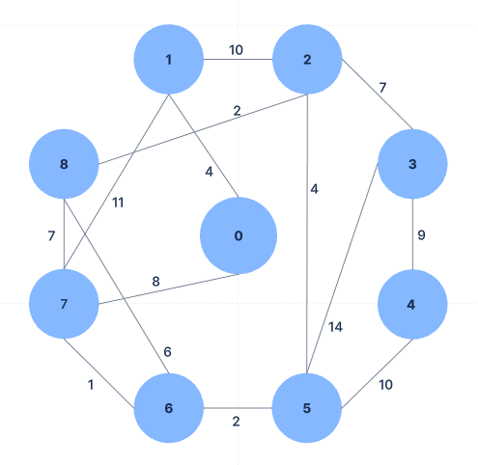
Input dataset :
Graph Description:
(0, 1) with weight 4
(0, 7) with weight 8
(1, 2) with weight 8
(1, 7) with weight 11
(2, 3) with weight 7
(2, 8) with weight 2
(2, 5) with weight 4
(3, 4) with weight 9
(3, 5) with weight 14
(4, 5) with weight 10
(5, 6) with weight 2
(6, 7) with weight 1
(6, 8) with weight 6
(7, 8) with weight 7

Slide 3
The input dataset represents a weighted, undirected graph with
9 vertices (numbered 0 through 8). The graph is defined by the
following edges and their
corresponding weights.
Graph Characteristics:
Connectivity: The graph is connected, as there is a path between any two vertices.
Undirected: All the edges in the graph are undirected, meaning the connection
between any two vertices is bidirectional.
Weighted: Each edge in the graph has an associated weight, which represents the cost
or distance between the connected vertices.

Slide 4
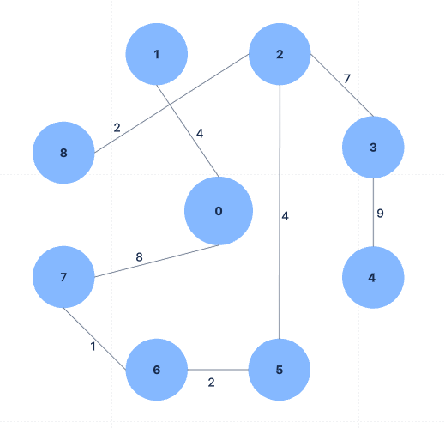
Output :
Minimum Spanning Tree (MST):
(0, 1) with weight 4
(1, 2) with weight 8
(2, 3) with weight 7
(2, 8) with weight 2
(2, 5) with weight 4
(3, 4) with weight 9
(5, 6) with weight 2
(6, 7) with weight 1
The total weight of this
MST is 37.

Slide 5
Potential Applications:
This graph could represent various real-world scenarios, such as:
Transportation Network: The vertices could represent cities, and the edges could
represent roads or flight routes between them, with the weights corresponding to the
travel distances or costs.
Telecommunication Network: The vertices could represent network nodes, and the edges
could represent communication links between them, with the weights representing the
cost or bandwidth of the connections.
Utility Network: The vertices could represent consumers or distribution points, and the
edges could represent pipelines or power lines, with the weights representing the cost or
capacity of the connections.
In such scenarios, the Minimum Spanning Tree found by Prim's algorithm would represent
the most cost-effective way to connect all the vertices while ensuring that the entire network remains
functional.

Slide 6

Algorithm :
Prim's algorithm is a greedy algorithm used to find the Minimum
Spanning Tree (MST) of a weighted, undirected graph. The
algorithm starts with a single vertex and iteratively adds the
nearest unvisited vertex to the growing MST, until all vertices are
included.
Advantages:
Greedy Approach: Prim's algorithm follows a greedy approach,
where it always chooses the nearest unvisited vertex to
add to the MST. This makes it an efficient algorithm for
finding the MST.
Handles Disconnected Graphs: Prim's algorithm can handle
disconnected graphs by starting the MST construction
from different components.
Versatility: The algorithm can be implemented using both
adjacency matrix and adjacency list representations of the
graph, depending on the graph's density.

Slide 7
Algorithm Steps:
1. Initialization:
Create arrays to store the MST:
parent[]: To store the parent of each vertex in the MST.
key[]: To store the minimum weight (key) of each vertex.
inMST[]: To track which vertices are already included in the MST.
Initialize all key values to Integer.MAX_VALUE and all inMST values to false.
Create a PriorityQueue to efficiently retrieve the vertex with the minimum key value.
Start with vertex 0 by setting its key to 0, its parent to -1, and adding it to the priority queue.
2. Main Algorithm Loop:
While the priority queue is not empty:
Poll the vertex u with the minimum key value from the priority queue.
Mark u as included in the MST by setting inMST[u] to true.
For each adjacent vertex v of u:
If v is not yet in the MST (!inMST[v]) and the weight of the edge (u, v) is less than the current key value of v (weight < key[v]):
Update the parent[v] to u.
Update the key[v] to the weight of the edge (u, v).
Add the updated vertex v to the priority queue.
3. Output:
The parent[] array now contains the parent of each vertex in the MST, allowing you to reconstruct the MST.
You can print the edges and weights in the MST using the parent[] array.

Slide 8
Report on:- Depth First Search(DFS)

Slide 9
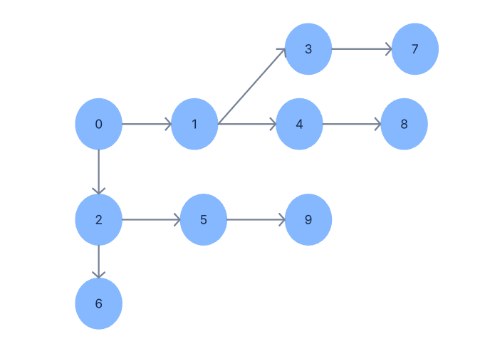
Now according to DFS(Depth First search):-
Graph Structure:-
The graph has the following structure based on the addEdge method calls:
Vertex 0 has edges to 1 and 2.
Vertex 1 has edges to 3 and 4.
Vertex 2 has edges to 5 and 6.
Vertex 3 has an edge to 7.
Vertex 4 has an edge to 8.
Vertex 5 has an edge to 9.

Slide 10
DFS Traversal Process
Starting from vertex 0, the DFS traversal will follow this path:
Visit 0 and mark it as visited.
Move to 1 (neighbor of 0) and mark it as visited.
Move to 3 (neighbor of 1) and mark it as visited.
Move to 7 (neighbor of 3) and mark it as visited.
Backtrack to 1 (since 7 has no more neighbors).
Move to 4 (next unvisited neighbor of 1) and mark it as visited.
Move to 8 (neighbor of 4) and mark it as visited.
Backtrack to 0 (since 1's neighbors are all visited).
Move to 2 (next unvisited neighbor of 0) and mark it as visited.
Move to 5 (neighbor of 2) and mark it as visited.
Move to 9 (neighbor of 5) and mark it as visited.
Backtrack to 2 (since 5 has no more neighbors).
Move to 6 (next unvisited neighbor of 2) and mark it as visited.
Final DFS Traversal Output
The traversal order will be: 0 1 3 7 4 8 2 5 9 6

Slide 11
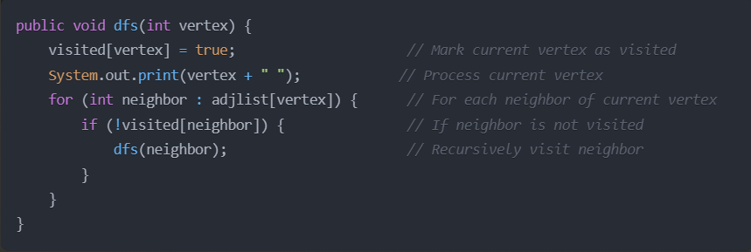
Algorithm of DFS:-

Slide 12
THANK YOU

